Slide 1
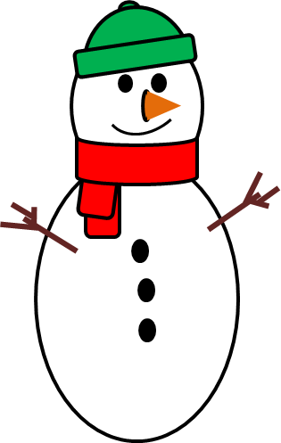
Counting to 10.
1 2 3 4 5 6 7 8 9 10

Slide 2
Can you count the snowmen?
2
3
4

Slide 3
Try Again
?

Slide 4
Try Again
?

Slide 5

Correct!
Play again

Slide 6
Can you count the snowmen?
2
4

Slide 7
Try Again
?

Slide 8
Correct!
Play again

Slide 9
Can you count the snowmen?
2

Slide 10
Can you count the snowmen?
2
3

Slide 11
Try Again
?

Slide 12
Correct!
Play again

Slide 13
Can you count the snowmen?
2

Slide 14
Can you count the snowmen?
3
4
5

Slide 15
Can you count the snowmen?
4
5

Slide 16
Can you count the snowmen?
3
4

Slide 17
Can you count the snowmen?
4

Slide 18
Try Again
?

Slide 19
Try Again
?

Slide 20
Try Again
?

Slide 21
Correct!
Play again

Slide 22
Can you count the snowmen?
5
6
7

Slide 23
Can you count the snowmen?
6
7

Slide 24
Can you count the snowmen?
5
7

Slide 25
Can you count the snowmen?
7

Slide 26
Try Again
?

Slide 27
Try Again
?

Slide 28
Try Again
?

Slide 29
Correct!
Play again

Slide 30
Can you count the snowmen?
7
8
9

Slide 31
Can you count the snowmen?
8
9

Slide 32
Can you count the snowmen?
7
8

Slide 33
Can you count the snowmen?
8

Slide 34
Try Again
?

Slide 35
Try Again
?

Slide 36
Try Again
?

Slide 37
Correct!
Play again

Slide 38
Can you count the snowmen?
8
9
10

Slide 39
Can you count the snowmen?
9
10

Slide 40
Can you count the snowmen?
8
10

Slide 41
Can you count the snowmen?
10

Slide 42
Try Again
?

Slide 43
Try Again
?

Slide 44
Try Again
?

Slide 45
Correct!
Congratulations

Slide 46
Well done!
You can count to 10.
Awarded to:_ _ _ _ _ _ _ _ _ _ _ _ _ _

